Slide 1
Next Gen App Architecture Trends
Disaggregated architecture for the cloud and device, capabilities served by the DSA/chiplet and orchestrated by the hardware and software “BUS”
Industry APIs exposed by the software/hardware capsules
The traditional OS functionalities are offloaded to the capsules and the OS is becoming the management and glue layer
The application framework is orchestrating the underline capsules with the industry APIs through the traditional APIs or WASM FFI integration

Slide 2
OpenHarmony
Android
Developer Ecosystem
C/C++
JS
Java
ACE UIKit (C++ libs w/ React Native fork)
Software BUS
HarmonyOS
（ASOP fork, OpenARK, HMS）
HAL
Linux
Linux
LiteOS M
LiteOS Tiny
Mobile SoC
ARM SoC
ARM A
ARM Cortex M

Slide 3
Key WASM technology planning areas
WASM runtime/engine
Browser WASM as is – chrome, safari
Wasmtime – JIT, Rust, Cranelift
WasmEdge – AOT, C++, LLVM
WAMR – Interpreter, C/C++, LLVM
WASM capabilities + Rust shim layer/Rust rewrite
NPU runtime, WASI NN
GPU, GLSL shader language, SPIR-V intermedia
OpenXR, WebXR
Sycl IoT, Khronos group?
Sensor Hub
New WASM OS
Rust OS? Theseus OS+WASM
Mesalock, Linux userspace Rust rewrite
WASM orchestration framework, WASM
Rust DSL for WASM orechestration – AssemblyScrpt, Rhai, Nushell
WASM Edge – zenoh, zenoh-flow, Anna storage, deployment, orchestration, ops, open telemetry,

Slide 4
Ultimate architecture vision
Apps
Apps
Apps
Apps
Apps
Apps
Apps
Apps
Apps
App Framework – MVVM
Game Framework – ECS, Behavior Tree
XR Framework – Behavior Tree
UI Layout DSL
Scenegraph DSL
DAG graph DSL
Unified Polyglot API/Function Embedding
Pub/Sub
Physics
CoreML
WASM NN
Metal
Cupertino
Connectivity
OpenMedia
K/V store
OpenXR
OpenID?
Lang VM (Rust preferred)
WASM Engine
OS
CPU
NextGen Bus + Chiplet + Advanced packaging
Networking
Physics
AI
UI
Connectivity
A/V Media
Storage/DB
Controller
Security
WASM
OS
WASM
OS
WASM
OS
WASM
OS
WASM
OS
WASM
OS
WASM
OS
WASM
OS
WASM
OS
Ethernet
PPU
NPU
GPU
SensorHub
MPU
PIM/FLASH
SensorHub/GPU
SPU

Slide 5
集成能力容器
Disaggrated 架构的优势
软件硬件协同设计，优化性能和功耗（AWS nitro卸载）
更好的供应链管理，拜托CPU/OS生态控制（手机sensorhub，智能手表）
符合能力发展趋势，AI，多模，图像为代表的异构计算模式
符合后摩尔时代半导体技术的趋势，异构集成，优化技术效能
Capability based OS趋势
Rust为代表的Tock OS的capsul，theseus OS的cell，是OS的micro kernel趋势的延续
WASM+Rust是未来能力化OS的基础技术
灵活的能力访问
可以是API调用
也可以在能力硬件中动态部署WASM代码
Apps
Apps
Apps
Apps
Apps
Apps
Apps
Apps
Apps
App Framework – MVVM
Game Framework – ECS, Behavior Tree
XR Framework – Behavior Tree
UI Layout DSL
Scenegraph DSL
DAG graph DSL
Unified Polyglot API/Function Embedding
Pub/Sub
Physics
CoreML
WASM NN
Metal
Cupertino
Connectivity
OpenMedia
K/V store
OpenXR
OpenID?
Lang VM (Rust preferred)
WASM Engine
OS
CPU
NextGen Bus + Chiplet + Advanced packaging
Networking
Physics
AI
UI
Connectivity
A/V Media
Storage/DB
Controller
Security
WASM
OS
WASM
OS
WASM
OS
WASM
OS
WASM
OS
WASM
OS
WASM
OS
WASM
OS
WASM
OS
Ethernet
PPU
NPU
GPU
SensorHub
MPU
PIM/FLASH
SensorHub/GPU
SPU

Slide 6
CPU+OS 瘦身，可信计算
传统CPU+OS职能转换
提供用户和能力的连接
提供逻辑和数据胶水能力
提供Rust和WASM的运行引擎
基于Rust和WASM的可信OS
能力微内核（capsule, cell）
可信访问
单地址空间
Ring0 空间运行App
Apps
Apps
Apps
Apps
Apps
Apps
Apps
Apps
Apps
App Framework – MVVM
Game Framework – ECS, Behavior Tree
XR Framework – Behavior Tree
UI Layout DSL
Scenegraph DSL
DAG graph DSL
Unified Polyglot API/Function Embedding
Pub/Sub
Physics
CoreML
WASM NN
Metal
Cupertino
Connectivity
OpenMedia
K/V store
OpenXR
OpenID?
Lang VM (Rust preferred)
WASM Engine
OS
CPU
NextGen Bus + Chiplet + Advanced packaging
Networking
Physics
AI
UI
Connectivity
A/V Media
Storage/DB
Controller
Security
WASM
OS
WASM
OS
WASM
OS
WASM
OS
WASM
OS
WASM
OS
WASM
OS
WASM
OS
WASM
OS
Ethernet
PPU
NPU
GPU
SensorHub
MPU
PIM/FLASH
SensorHub/GPU
SPU

Slide 7
基于工业标准的能力开放
基础能力开放
拉通工业标准能力API和底层能力
北向提供多语言、多样化的集成模式
桥接API
类Rest的RPC调用
WASM embedding
归一化语言的优化
无数据串行化代价
无数据类型转换代价
用户代码和能力函数通过共享内存集成
Apps
Apps
Apps
Apps
Apps
Apps
Apps
Apps
Apps
App Framework – MVVM
Game Framework – ECS, Behavior Tree
XR Framework – Behavior Tree
UI Layout DSL
Scenegraph DSL
DAG graph DSL
Unified Polyglot API/Function Embedding
Pub/Sub
Physics
CoreML
WASM NN
Metal
Cupertino
Connectivity
OpenMedia
K/V store
OpenXR
OpenID?
Lang VM (Rust preferred)
WASM Engine
OS
CPU
NextGen Bus + Chiplet + Advanced packaging
Networking
Physics
AI
UI
Connectivity
A/V Media
Storage/DB
Controller
Security
WASM
OS
WASM
OS
WASM
OS
WASM
OS
WASM
OS
WASM
OS
WASM
OS
WASM
OS
WASM
OS
Ethernet
PPU
NPU
GPU
SensorHub
MPU
PIM/FLASH
SensorHub/GPU
SPU

Slide 8
基于基础能力的应用框架
基于基础能力支持不同应用场景，或者共存
应用框架提供设计模式和用户应用开发环境
应用开发环境需要用户DSL编程语言
前端框架微服务化
用户代码对基础能力做orchestration
能力基于WASM封装
Apps
Apps
Apps
Apps
Apps
Apps
Apps
Apps
Apps
App Framework – MVVM
Game Framework – ECS, Behavior Tree
XR Framework – Behavior Tree
UI Layout DSL
Scenegraph DSL
DAG graph DSL
Unified Polyglot API/Function Embedding
Pub/Sub
Physics
CoreML
WASM NN
Metal
Cupertino
Connectivity
OpenMedia
K/V store
OpenXR
OpenID?
Lang VM (Rust preferred)
WASM Engine
OS
CPU
NextGen Bus + Chiplet + Advanced packaging
Networking
Physics
AI
UI
Connectivity
A/V Media
Storage/DB
Controller
Security
WASM
OS
WASM
OS
WASM
OS
WASM
OS
WASM
OS
WASM
OS
WASM
OS
WASM
OS
WASM
OS
Ethernet
PPU
NPU
GPU
SensorHub
MPU
PIM/FLASH
SensorHub/GPU
SPU

Slide 9
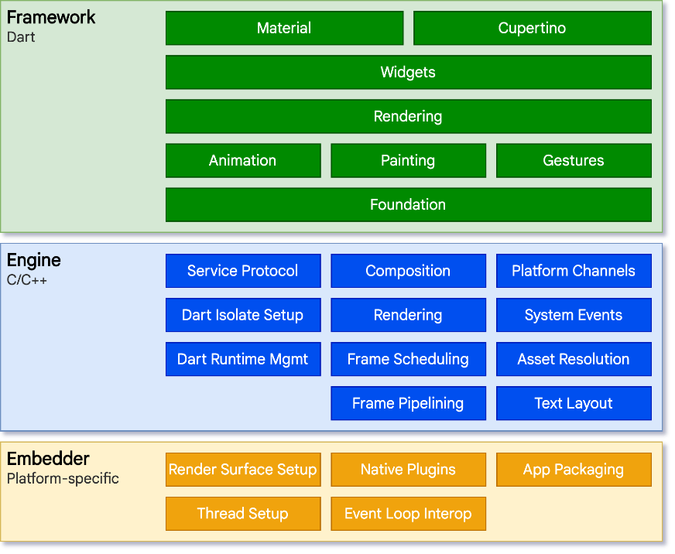
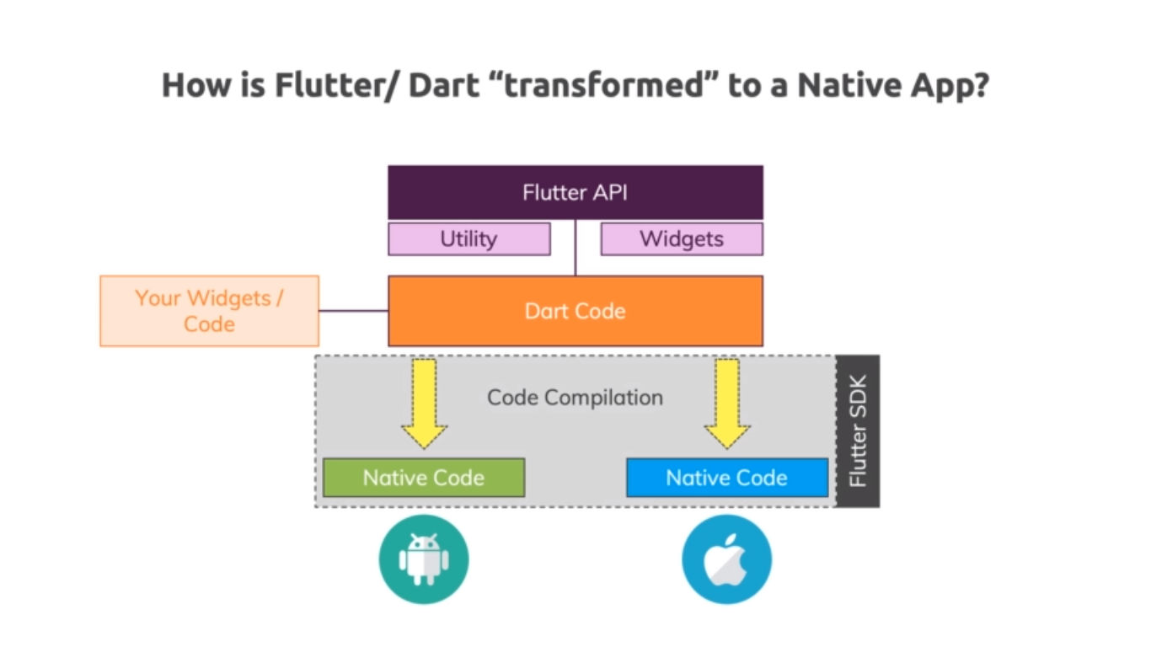
Flutter 战略
通过跨平台的UIKit 获取开发者，可以寄生在既有平台，也可以和Fuschia会师构成完整平台
一套代码，跨平台部署
iOS, Android, Web, Fuschia
原生App性能
Skia图形引擎和自绘原生支持iOS和Andriod的组件库，消除了底层使用webview等异构引擎的开销
DART用于引擎和用户侧语言，相比其他hybrid框架，降低数据bridge带来的开销
DART语言和平台适配层实现和底层平台的高性能集成
DART应用和平台适配层编译为支持iOS和Android的C/C++ ABI，Flutter作为iOS/Android library集成
DART语言双模设计
在开放阶段支持JIT模式，hot reloading，加快开放迭代速度
在产品发布阶段支持AOT模式，提供性能和安全

Slide 10
HM 战略，通过WASM+浏览器实现跨平台
构建HM跨平台UIKit层
C/C++，Rust 的UI library =》WASM
Skia 已经可编译为WASM Canvaskit
WASM 编程语言
C/C++, Rust平滑编译为WASM，WASM UIKit编译为libraries实现和flutter类似的和iOS/Android集成
Interface type提供多语言集成，用户态语言和UIKit公共WASM集成
WASM sandbox实现安全集成
基于WASM的平台适配层
WASI 提供对OS的抽象
WASM AOT =》平台Library
WASM vs DART
WASM支持多语言集成
WASM没有开发者的learning curve
提供和DART一样的JIT和AOT
WASM AOT 性能存在安全带来的性能代价
Layout
Biz Logic
Data Graph
Libs
Layout
Biz Logic
Data Graph
Libs
JS: RN, VUE
Rust, C/C++ frameworks
HMS APIs/Function Embeddings
HM UIKit Engine
WASM+JS JIT Compiler
WASM AOT Runtime
Web Capability APIs
OS Capability APIs
Browser
Android/iOS

Slide 11
通过WASM以软能力胶囊寄生在浏览器生态
Apps
Apps
Apps
Apps
Apps
Apps
Apps
Apps
Apps
App Framework – MVVM
Game Framework – ECS, Behavior Tree
XR Framework – Behavior Tree
UI Layout DSL
Scenegraph DSL
DAG graph DSL
Unified Polyglot API/Function Embedding
Pub/Sub
Physics
CoreML
WASM NN
Metal
Cupertino
Connectivity
OpenMedia
K/V store
OpenXR
OpenID?
Lang VM (Rust preferred)
WASM Engine
Networking
Physics
AI
UI
Connectivity
A/V Media
Storage/DB
Controller
Security
OS
CPU

Slide 12
App新语言的趋势
趋势判断
Low coding, no coding是前端发展的趋势，设计和实现一体的IDE（figma, webflow），声明式编程的普遍采纳
Micro-frontend，大厂内部实现了App能力组件化，云端和前端主要工作是粘贴和组合，相应的SaaS工具（https://bit.dev/，https://www.framer.com/）
针对对domain的DSL配合compiler优化domain问题，例如：JS之上发展出来的DSL，伯克利hydro-flow项目基于Rust构建的多个DSL
新语言的战略
底座语言做能力：系统语言，性能，安全，跨平台，多语言集成，值得长期投资
胶水语言粘用户：拉通设计和工程，low coding，no coding，组件化，服务化，胶水DSL语言
投资在基础底座语言上构建DSL的能力，通过开放社区快速迭代（微软的TS战略）
透明更换底座：把JS的DSL变为Rust DSL，提升性能和安全性

Slide 13
App前端语言的机会
前端语言的多样场景，导致已经在JS上长出不同的DSL
Layout 设计，声明式编程主导
– React JSX, RAX, 基于JS的DSL，通过Babel transcompile到JS
SwiftUI，Jetpack
业务逻辑
TypeScript，强类型，通过Babel transcompile到JS
Dart，强类型，通过dart2js transcompile到JS
计算类型
C/C++，Rust，通过asm.js compile 到JS
数据ORM
GraphQL，拉通前后台的数据图描述
基于Rust的DSL对标前端JS DSL
排版布局
Makepad 的 shader DSL，兼容CSS，借鉴sharder DSL，充分利用GPU （ https://github.com/makepad/makepad_docs/blob/main/Makepad%20Whitepaper%202020.pdf ）
业务逻辑
TS, JS compiler in Rust, https://github.com/swc-project/swc
通过WASM支持多种语言编写业务逻辑
计算类型
WASM的能力库
数据ORM
支持GraphQL in Rust

Slide 14
WASM orchestration DSL 的机会
WASM生态需要新的语言
低开销部署，否则破坏了WASM的优点
系统语言，可以和OS和WASM紧密整合
系统生态丰富
易学，开发速度快
Go被Docker以及K8S选择
Rust 具备支持DSL设计的特点
Macro 展开
泛型 polymorphism
强大的parser
也可以用于做编译器
已经广泛用于DSL设计，FB的move，伯克利的Hydroflow
Apps
Apps
Apps
Apps
Apps
DSL interpreter and APIs
CLI & REPL
Admin
Graph execution
Events
Log & Tracing
WASM Apps
WASM Apps
WASM Apps
WASM Apps
Rust Daemon
WASM Engine/Runtime
WASM Libs
WASM Repos
OS

Slide 15














GUI 发展趋势
Apps
Apps
声明式编程，拉通设计和实现流程，简化UI设计
GUI 无状态，App直接调用GPU APIs
同时支持2D，动画和3D
利用现代GPU的并行化计算能力，60fps
App和GUI的状态需要同步，用户程序复杂
只能优化2D显示，3D和动画需要单独stack
CPU为核心的渲染机制，没有充分利用GPU的并行计算模式
Declarative UI
Callback GUI APIs
Direct GUI APIs
GUI Objects
Shadow Retained Widget
Paint
Compositor
Buffer Optimization
Render task Optimization
Shader batching
Transcompiling
OS GUI APIs
GPU APIs

Slide 16
基于WASM的跨平台UIKit
Polygot Binding to the User App Languages
UI DSL 作为intrinsic嵌入用户语言，或在更高层面的声明式语言使用
DSL 代码被Rust编写的解释器在WASM内执行，DSL代码可以不断输入给解释器WASM
基于Rust实现immediate mode的GPU GUI，编译为WASM
DSL代码解释器和UI stack 编译为WASM作为Library和app代码链接
App logics
UI DSL Code
Rust DSL interpreter
Rust DSL interpreter
Shadow Retained Widget
Render task Optimization
Shader batching
Transcompiling
GPU APIs
CPUs

Slide 17
游戏/XR 业务前端语言
游戏场景渲染
Scengraph
游戏策略
Behavior tree
Scripting and plugins
Unity 支持C#, JS的pluging，已经支持WASM
Ulreal 支持C++，可以支持WASM

Slide 18
WASM in the Next Gen App
WASM basically makes C/C++ secure and modular
Can be used to package the C/C++ code assets
Easy for the computing intensive, need WASI for interfacing with the OS/HW
WASM is also natively integrated with Rust
Minimum performance loss, secure by static checking and runtime protection
Could have optimized integration, i.e. compiling process optimization
Benefits
Universal byte code/package running everywhere, e.g. XPUs
Secure sandbox, allowing running the 3rd party code everywhere, libraries for the foreign languages, inside OS kernels, inside applications
Refactor the OS, eliminated the kernel-user space separation
Capability based security model in WASI

Slide 19
Webassembly design principles
Integrated many language runtime/VM ideas from the past
JVM – WASI
LLVM, JavaScript, GraalVM/Truffle – language design
Universal byte code/packaging format
Secure sandbox
Control flow integrity
Single address space, boundary check
Unified language integration mechanism
Interface type standard
As a shared library for the foreign languages, WASM blobs integration
Abstraction of the OS
Almost OS agnostic, from Linux to RTOS or simple runtime
Low overhead
Flexible linking mechanism, micro services , micro modules
Benefit to the capability-based system

Slide 20
投资重点
充分利用Rust和WASM的产业机会，作为新的基于服务能力的计算架构的底座
人才的获取，标准的制定，生态的影响力
重点构建服务能力底座
短期借助既有的计算生态，软能力胶囊，寄生于既有生态，长期软件+芯片实现能力超越
参与能力标准的制定和引领
利用DSL语言和编译技术获取前端生态
顺应前端Low coding, no coding，微前端等趋势，重点投资能简化用户开发，降低开发成本的DSL和工具
在新兴业务领域抢先布局生态，例如：开放游戏引擎，XR 引擎
充分利用WASM带来的浏览器第二计算平台，构建寄生生态

Slide 21
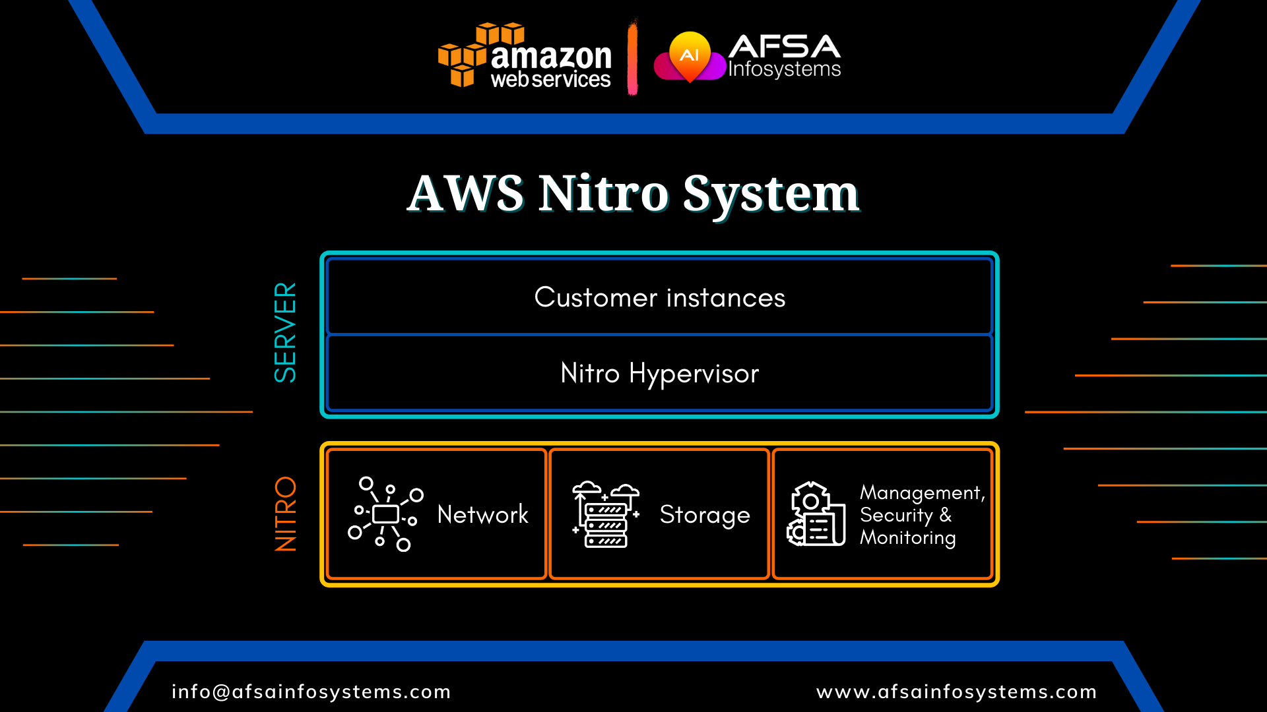
AWS Nitro卸载CPU负载

Slide 22
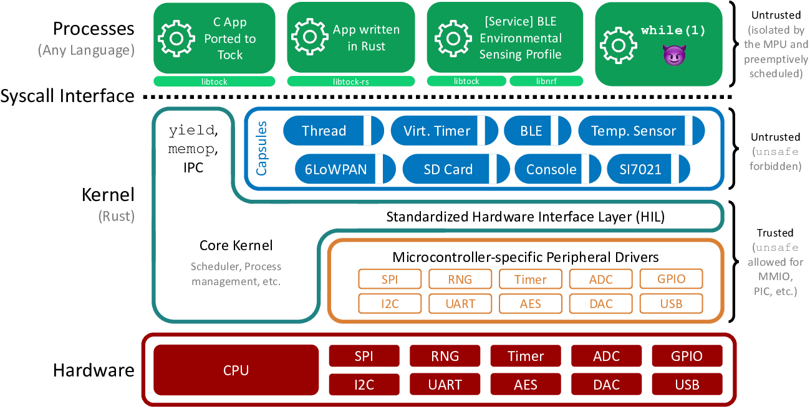
Capsule based Trustworthy OS

